Slide 1

FPGA-Based Emulation of a ReRAM Computing-in-Memory Model
Presentation for Master Thesis Proposal
Hrishikesh Karande

Slide 2
Outline
Introduction Problem Statement
Learnings
Challenges
Tentative Timeline

Slide 3
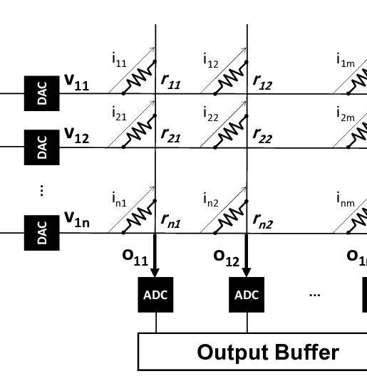
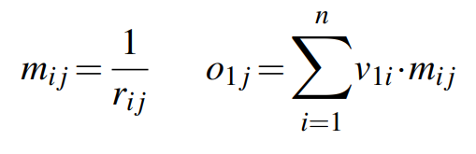
Introduction
ReRAM (Resistive Random-Access Memory)
ReRAM is a type of non-volatile memory that stores data by changing the resistance of a material. Applying voltage changes the resistance state — representing binary 0 or 1.
ReRAM cells are arranged in a grid (rows = word lines, columns = bit lines).
ReRAM is also attractive for in-memory computing because its crossbar arrays can perform matrix-vector multiplication directly using Ohm’s and Kirchhoff’s laws. This makes it ideal for accelerating AI workloads like neural networks.

Slide 4
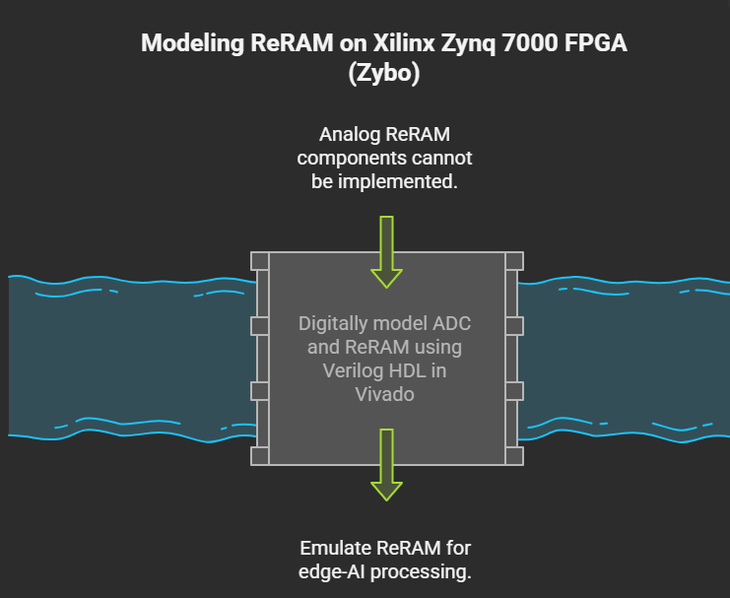
Problem Statement
Analog computation is powerful, but incompatible with digital-only FPGAs
ReRAM crossbars and ADCs naturally operate in the analog domain, which cannot be directly implemented on FPGAs like the Xilinx Zybo.
We emulate analog behavior using digital logic. To overcome this, we design a digital approximation of both an ADC and a ReRAM-based crossbar using Verilog and FPGA resources (LUTs, DSPs, BRAM).

Slide 5
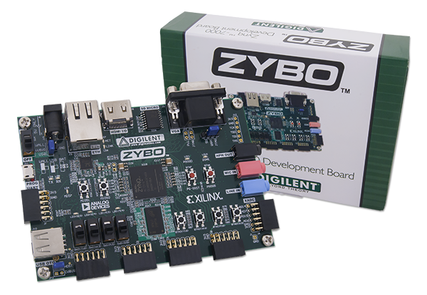
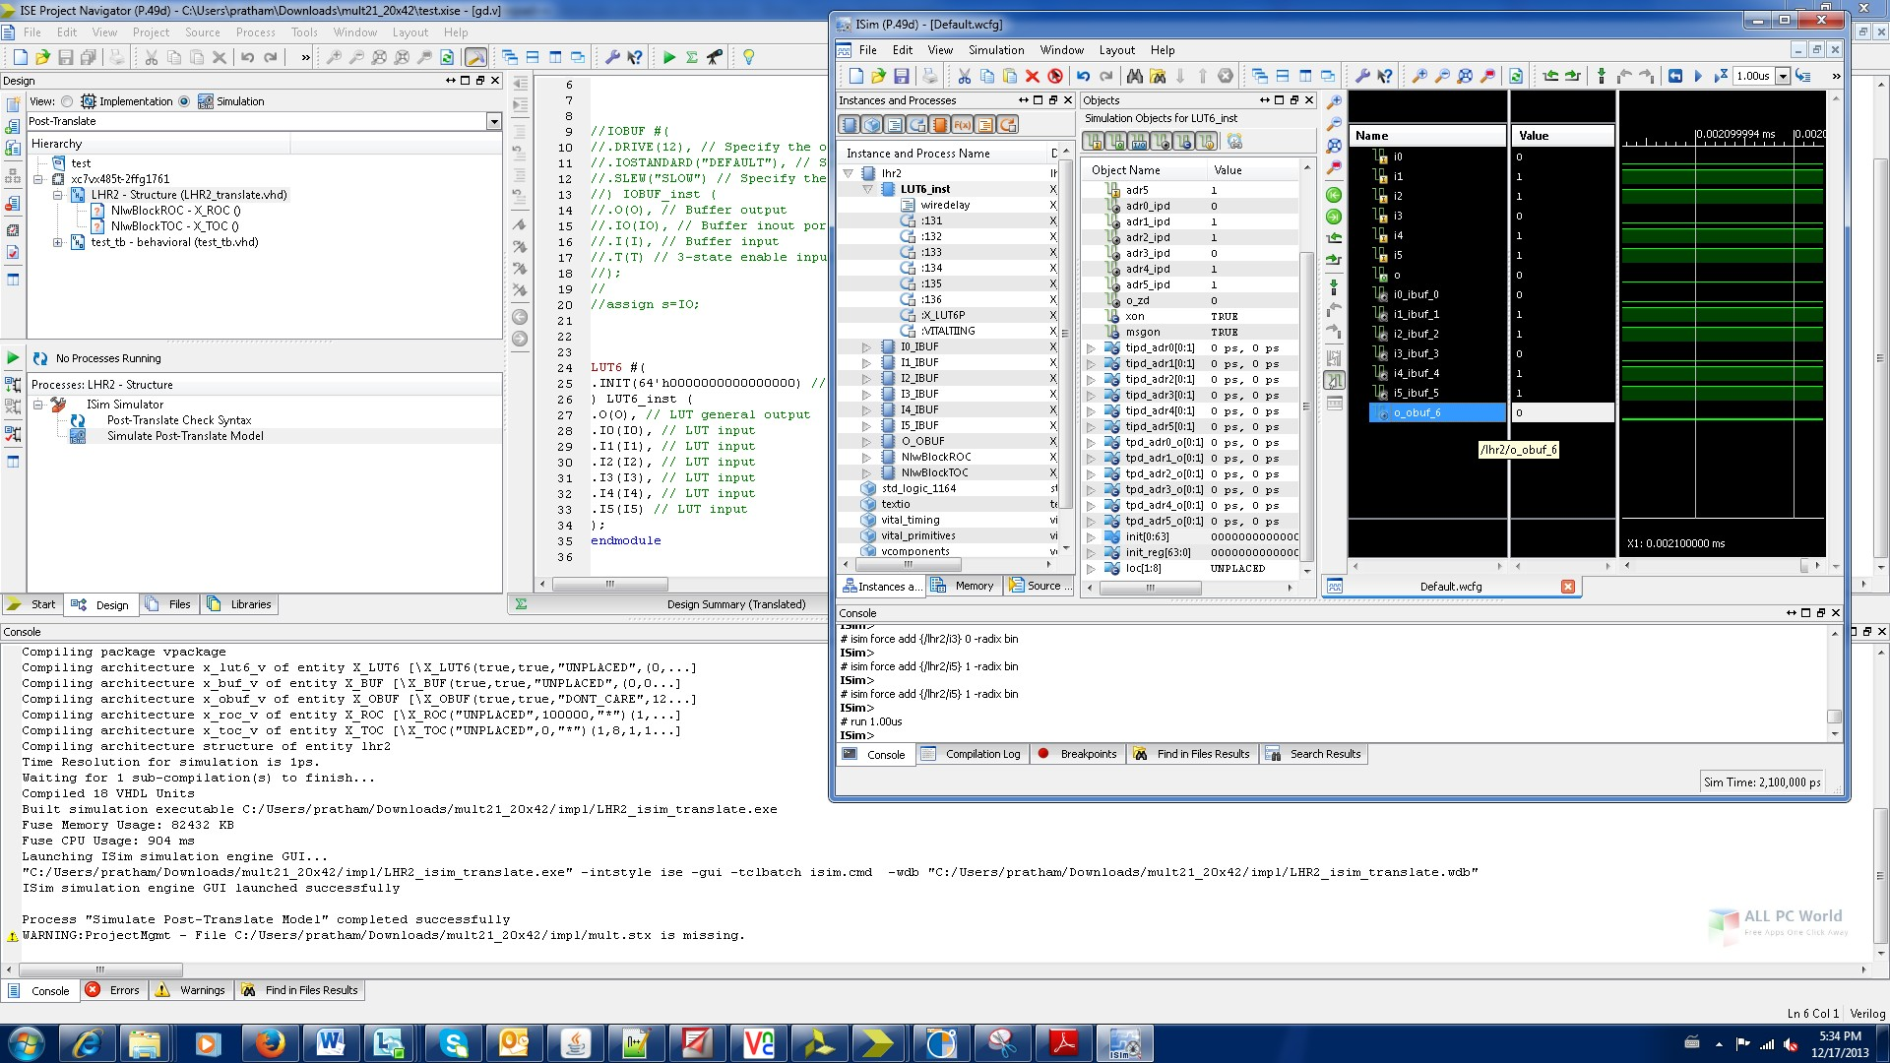
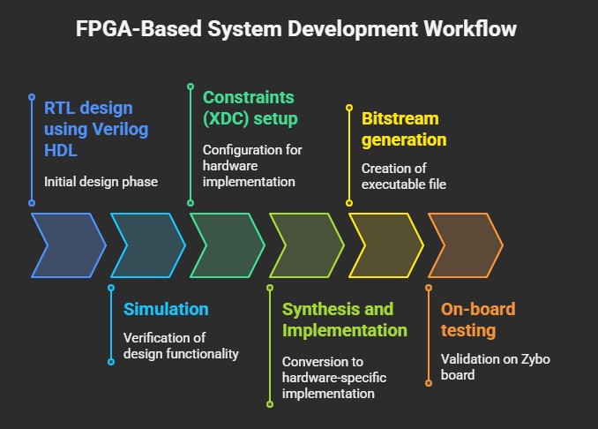
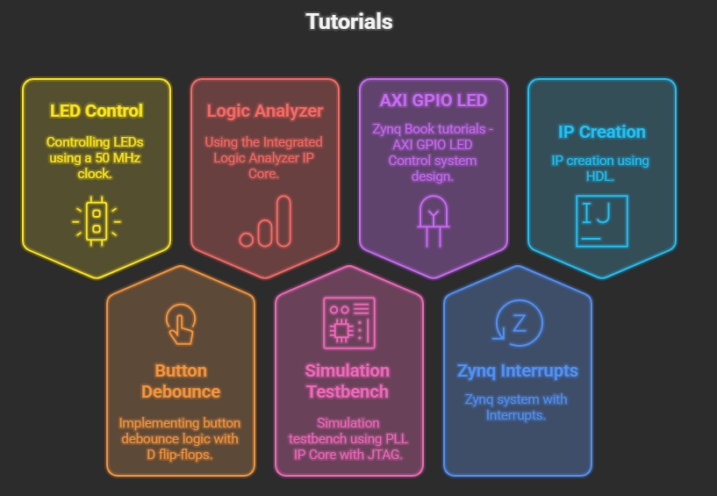
Learnings

Slide 6
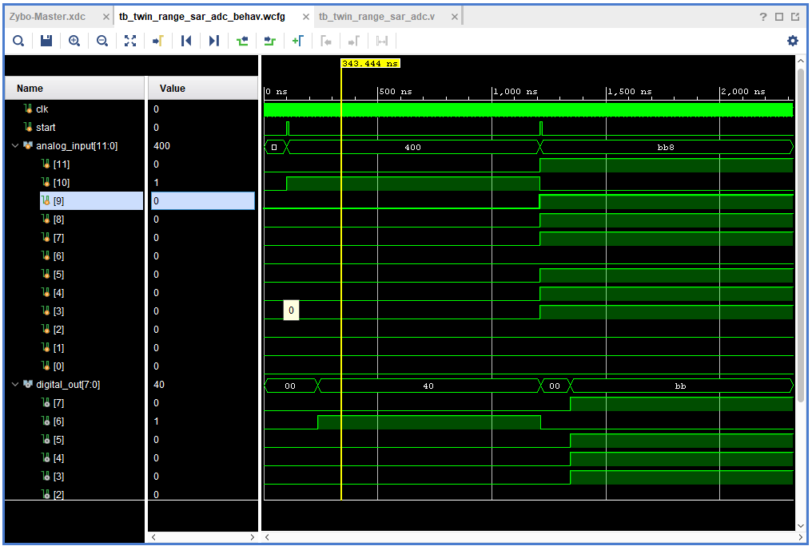
Challenges
Challenges in Integration and
Testing on hardware…
Simulation of TRQ ADC

Slide 7
Tentative Timeline
Phase 4: Testing and Validation (July - Aug)
Test generated code on the FPGA. Evaluate performance and accuracy.
Phase 5: Documentation and Reporting (Aug - Sep)
Document findings and create a Thesis Report. Propose improvements and possible generalizations. Phase 6: Presentation (End of Sep)
Submit the thesis report and prepare for thesis defense presentation.
Phase 1: Literature Study (April)
Research and study existing methods and tools.
Phase 2: Learning Vivado (May)
Do online tutorials on Vivado design Suite.
Register in unisono
Phase 3: Architecture Model Creation (June - July)
Model the ReRAM and ADC components in Verilog HDL

Slide 8
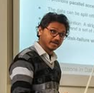
Thank You
Contact
Hrishikesh Karande hrishikesh.karande@student.uni-siegen.de

